Slide 1
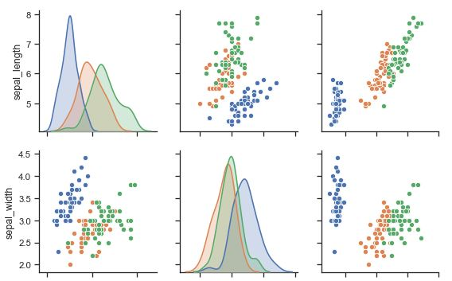





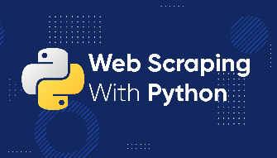

Basic Python Programming and Visualization (+ Data Analysis)
xx - xx Oct 2023
Mr. Pipatpon Mitasit
วิศวกรระดับ 7
แผนกวางแผนโครงการพลังงานหมุนเวียน (หวคม-พ.)
กองแผนงานและศึกษาความเหมาะสมพลังงานหมุนเวียน (กผศม-พ.)
ฝ่ายพัฒนาและแผนงานโรงไฟฟ้า (อผร.)
สายงานรองผู้พัฒนาโรงไฟฟ้า และ พลังงานหมุนเวียน (รวพ.)

Slide 2




Rules
K
CC BY-NC-SA includes the following elements: BY – Credit must be given to the creator NC – Only noncommercial uses of the work are permitted SA – Adaptations must be shared under the same terms

Slide 3









About
Be in B.Eng. (Electrical [Control] Engineering) KMUTNB (2nd class honors)
M.Eng. (Energy Engineering) KMUTNB
Mr. Pipatpon Mitasit
(Mc) – 33 Yrs
University
Electrical
Work
Before EGAT
Work
EGAT
Year 1-2
Year 3-4
Toyota
Scneider Electric Thailand
EGAT
2008
2010
2012 - 1 Year
2013 - 3 Month
2013 -2015
2014 - 2021
Present
First meet C/C++ , Java, PLC Programing Language
Embedded System / Micro Controller
Thesis : Power Electronics
First meet Powerful function Excel/VBA
Lean/Short Time Working
MATLAB Simulink Test/Design Software Module (Adaptive Cruise Control)
Designed Power Monitoring Software/Tools work with Scneider Power Meter Products via Database (PM-700)
Designed and Feasibility Study Solar / FPV / RE Power Plants
Planning Power Plant Projects
RE in PDP2018, PDP2022
Interest : Excel, Data Analytics , Data Analysis and Visualization
ASP.Net Web App Develop
AI Specialist : Data Management Platform (PMO)
AI Lecturer in EGAT
PUBLICATIONS: " Development of a Dual Axis Sun Tracking System with Astronomical Equation Program on Arduino Via GPS Module" ACSEE 2017 in Japan (ISSN:2186-2311 The Asian Conference on Sustainability, Energy & the Environment 2017)
Energy Engineering
Super AI Eng.
Proceeding
Presentation
VDO
2015
2021-2022
Thesis : Development of a Dual Axis Sun Tracking System with Astronomical Equation Program on Arduino Via GPS Module
Machine Learning / Deep Learning
Data Science / IoT
Natural Language Processing (NLP)
Image Processing / Signal Processing
Mathematics for AI
Programming and Tools in AI
Bronze Medal
To be continue:
CV
Super AI Season2 Shared
Linkedin
Github
Upwork
Kaggle
Medium

Slide 4
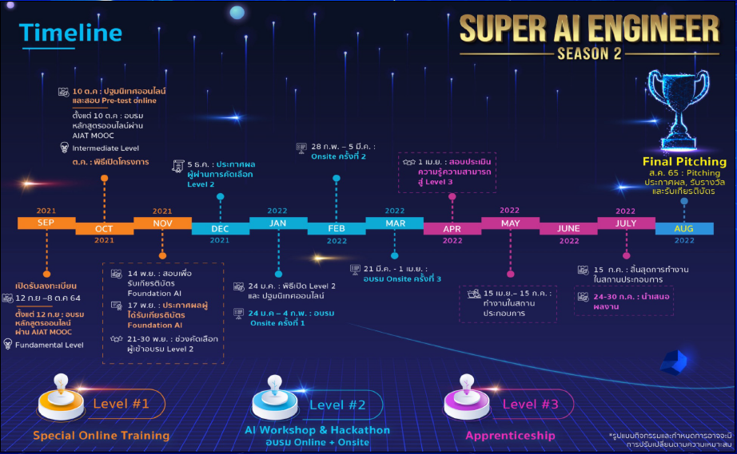

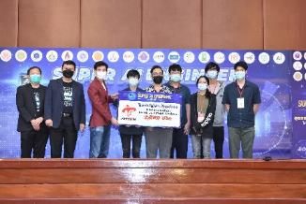

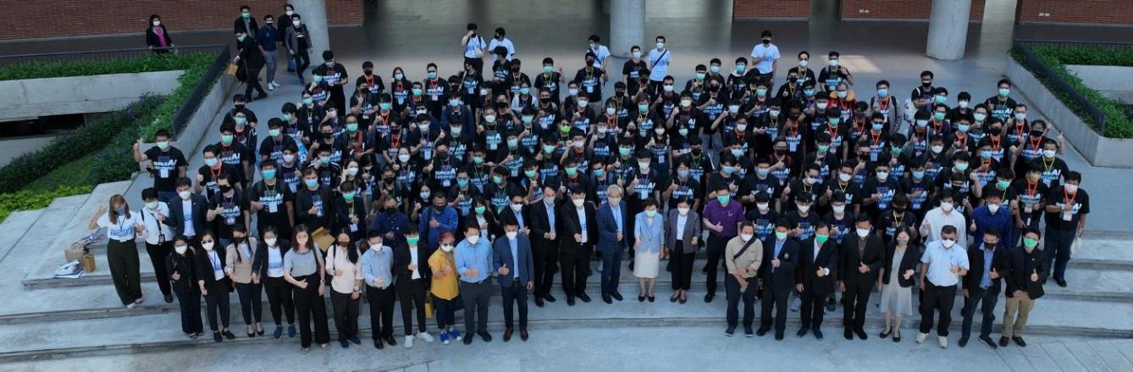
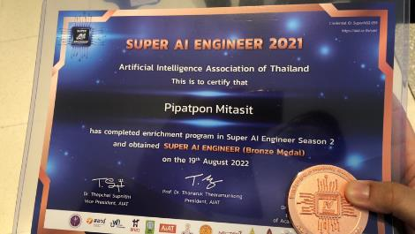

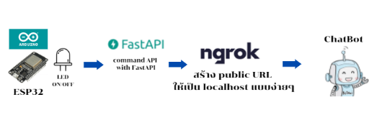
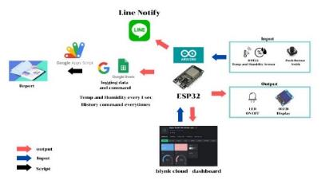
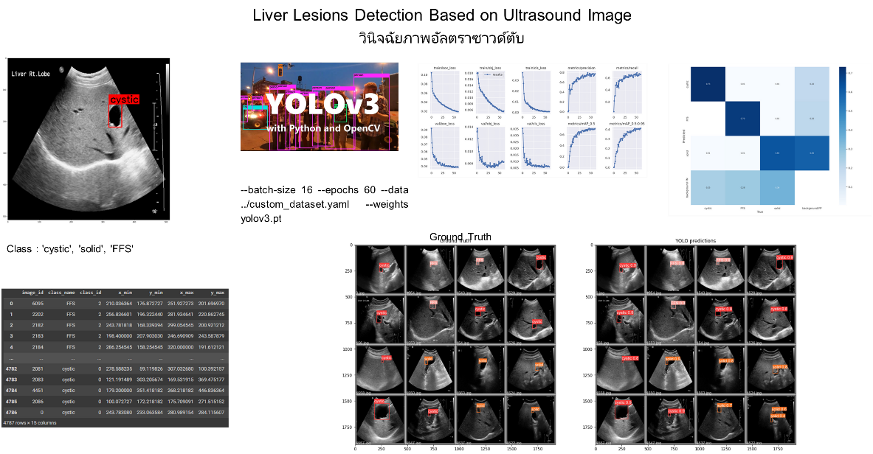


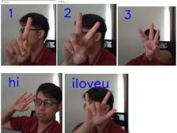
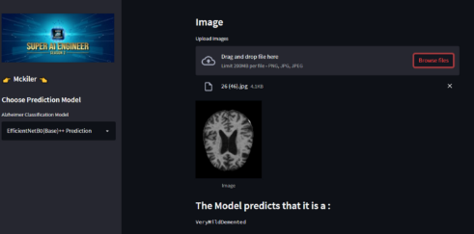


Super AI Engineer (Season 2)
5,600 Applicants
120 Applicants
Chatbot Command with IoT Link : Medium
Measuring Data with ESP32 built dashboard on Google sheet and new blynk dashboard Link : Medium
hand recognition with mediapipe Link : Medium
Image Processing (Alzheimer MRI Scan) Classification Link : Medium

Slide 5
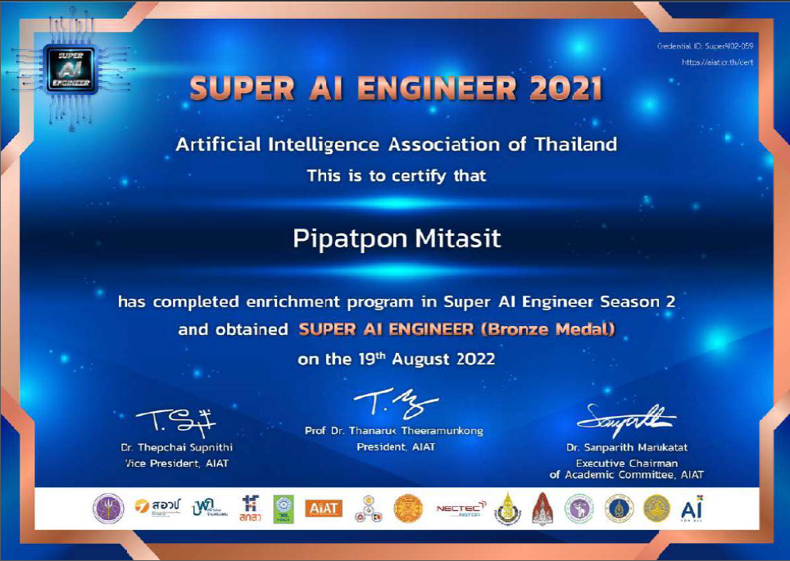
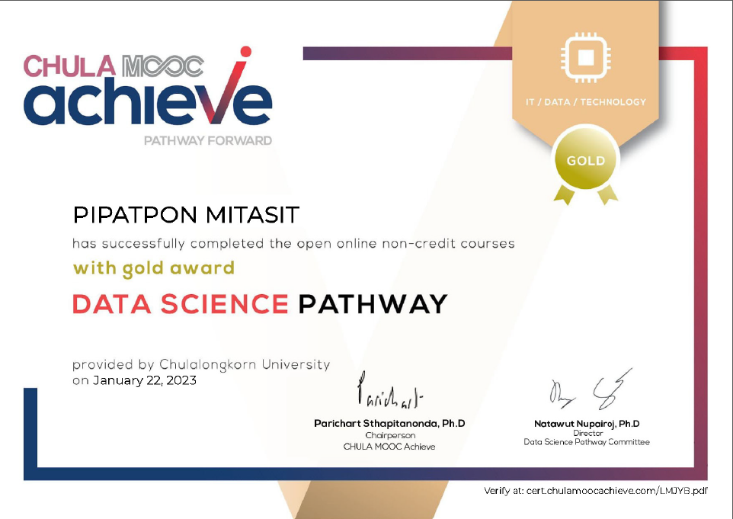
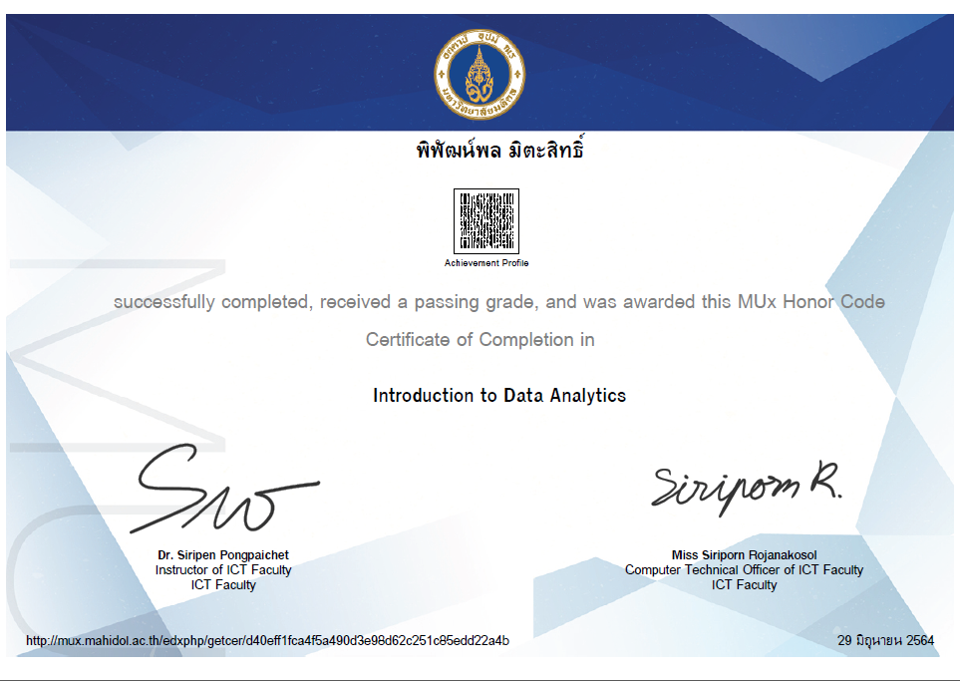
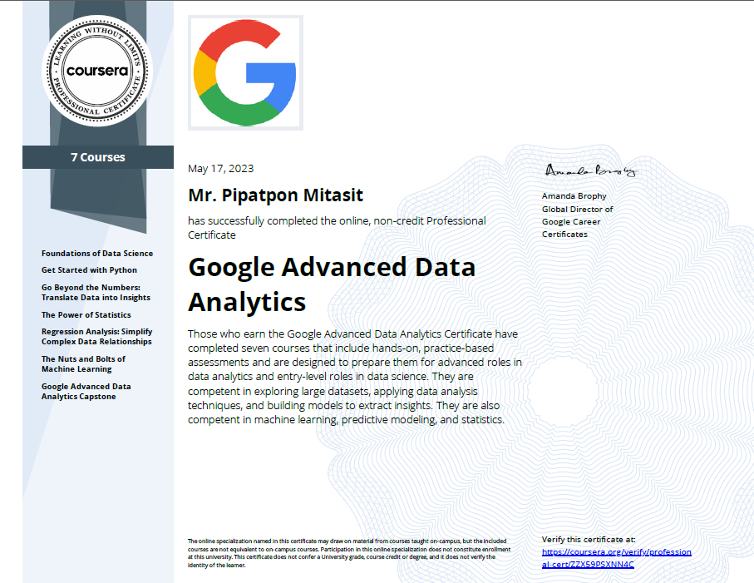

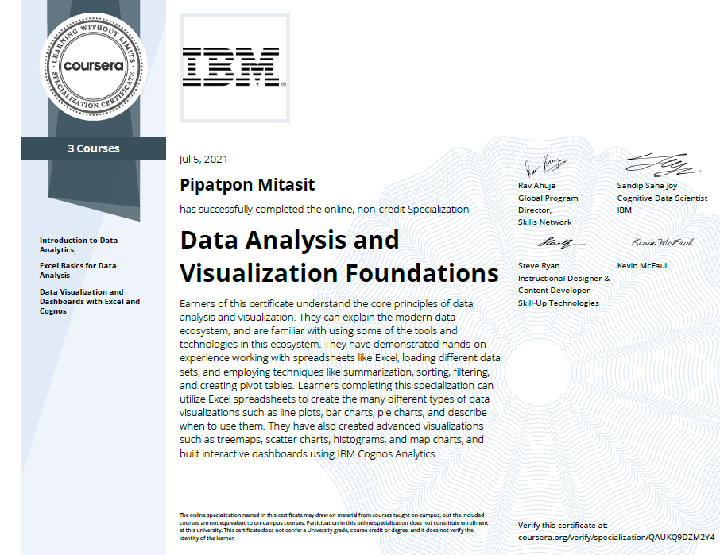
Cert.

Slide 6





Social Media
Data Mommie
Data Mommie

Slide 7
Agenda
DAY 1
9:00 – 12:00
Introduction to Data Science
Introduction to Python and Google Co-Lab
First for Use Google Colab
Python Operators and Variables
Function
Data Type
13:00 – 16:00
Conditional Statements
Data Type (List)
Loops in Python
Data Type (Dictionary)
Modules and library functions
DAY 2
9:00 – 16:00
Numpy
Pandas
13:00 – 16:00
1. Visualization with Matplotlib and Seaborn
DAY 3
9:00 – 16:00
Visualization with Matplotlib and Seaborn
13:00 – 16:00
Visualization with Matplotlib and Seaborn
Web Scraping with BeautifulSoup

Slide 8


Material
https://colab.research.google.com/drive/1ZdfQltlG7GyoxJUAEZMDdpYkROro8n6J?usp=sharing
https://github.com/DataMommie/2023_Basic_Python_Programming_Visualization_EGAT
Group Discord
Link Invite :
https://discord.gg/BbrZPAU9
Download App
https://discord.com/download

Slide 9
Introduction to Data Science

Slide 10
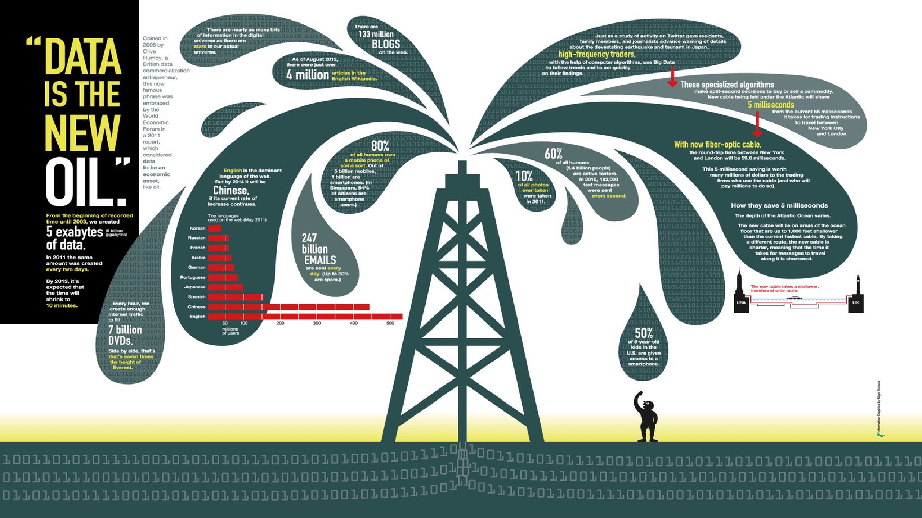

Slide 11
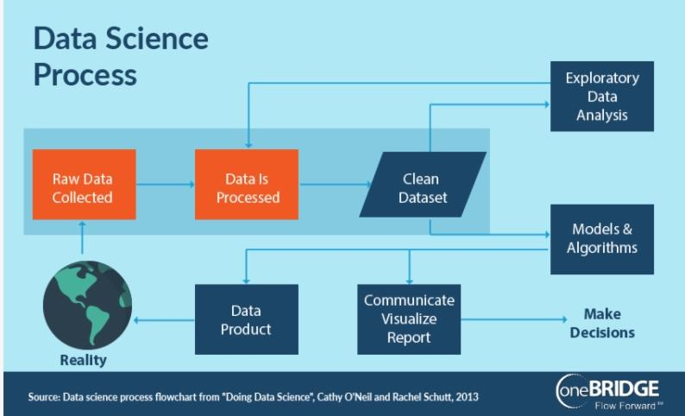
DATA -> DECISION

Slide 12
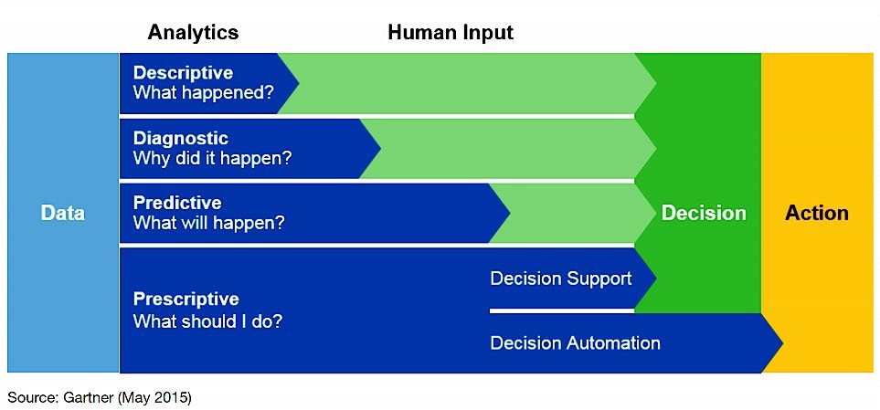
DATA -> DECISION

Slide 13
What is Data Science?
Data science is basically the newly developed blend of:
Math and Statistics
Mathematical Modeling
Statistical and Stochastic Modeling
Probability, …
Computer Science/IT
Artificial Intelligence (AI)
Pattern Recognition
Visualization
Data warehousing
Databases, …
Business Intelligence
Credit : Drew Conway’s Venn diagram of data science from 2010

Slide 14
What is Data Science?
With the help of constantly upgrading tools and technologies, we get to understand the social, commercial, as well as industrial processes.
Credit : https://www.meetup.com/ja-JP/Tokyo-Data-Science-Engineering-Business-Meetup-Group/

Slide 15
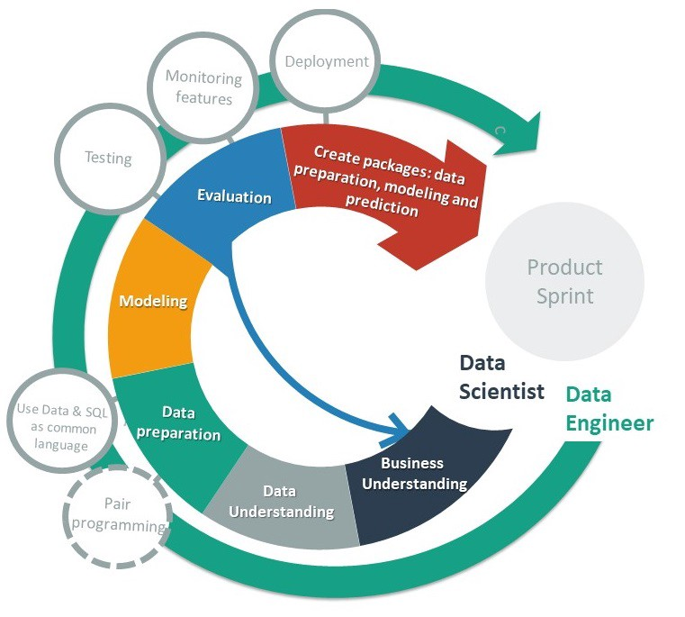
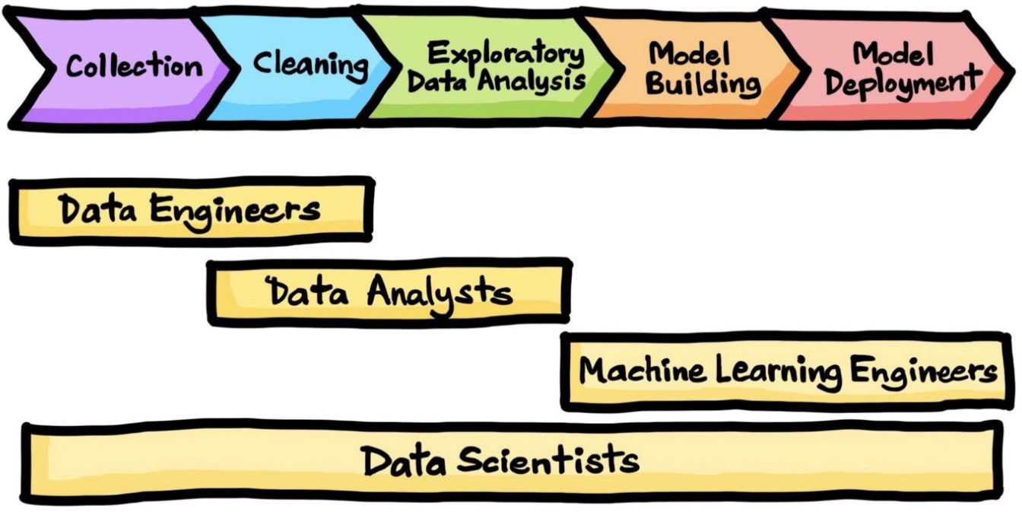
Data Science Life Cycle
Credit: The Data Science Process. A Visual Guide to Standard Procedures… | by Chanin Nantasenamat | Towards Data Science
Credit: https://miro.medium.com/max/2400/1*-8sSf4po2pm-fzhBU7CUmQ.jpeg

Slide 16
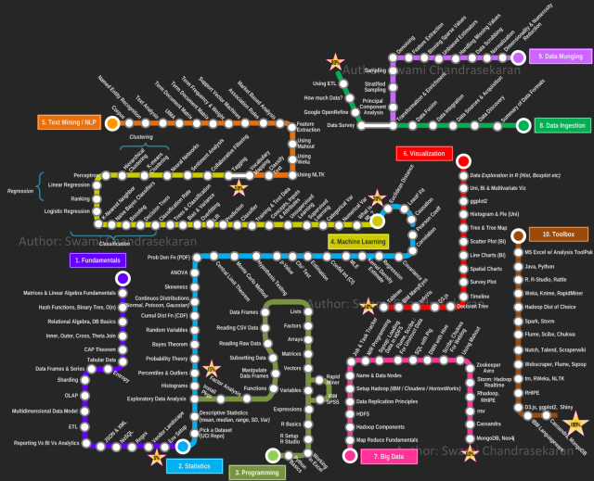
Data Scientist Roadmap
Credit: https://whatsthebigdata.com/2013/07/12/visualising-the-road-to-becoming-a-data-scientist/

Slide 17

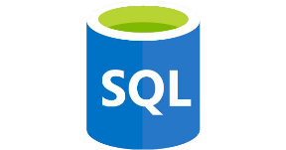



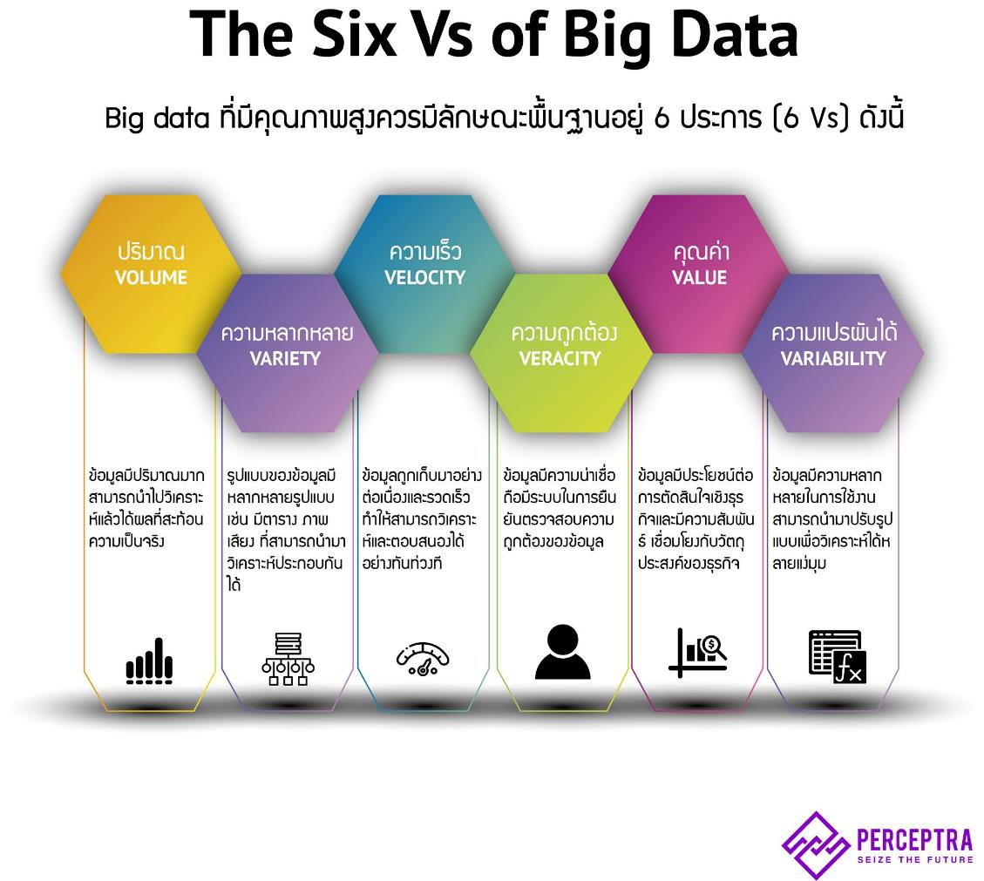
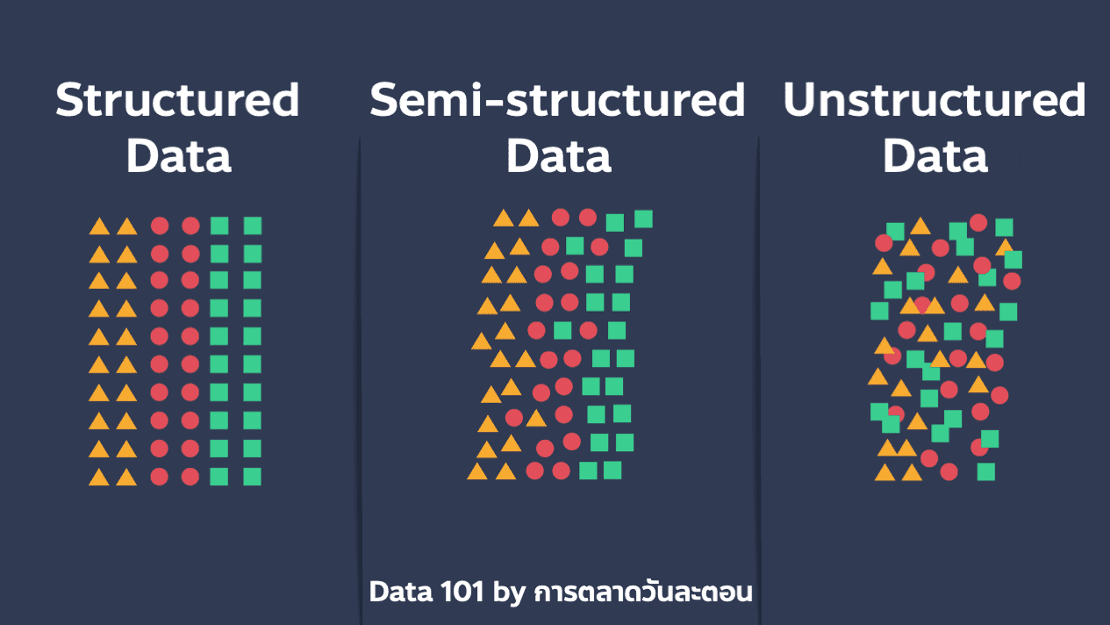
What is Data?
Structured data
Unstructured data
เช่น ข้อมูลใน Excel, จำนวนการซื้อขายกับลูกค้า, เปอร์เซ็นต์ความเคลื่อนไหวภายในตลาดหุ้น ฯลฯ
เช่น รูปแบบของรูปภาพ คลิปวิดีโอ ไฟล์เสียง หรือบทสนทนาโต้ตอบกับลูกค้าทาง Social Media
Semi structured data
เช่น สเตตัส ใน Social Media เป็นข้อมูลที่ไม่มีโครงสร้าง แต่ในกรณีที่มี Hashtag (#) เข้ามาช่วยในการจัดหมวดหมู่ จะทำให้ข้อมูลมีความเป็นระเบียบขึ้นมาเล็กน้อย

Slide 18

Introduction to Python
บิดา ภาษา Python ชื่อว่า Guido van Rossum
Born 31 January 1956
was born and raised in the Netherlands
Master's degree in mathematics and computer science from the University of Amsterdam in 1982.
Dutch
ภาษา Python เกิดขึ้นปี 1990

Slide 19
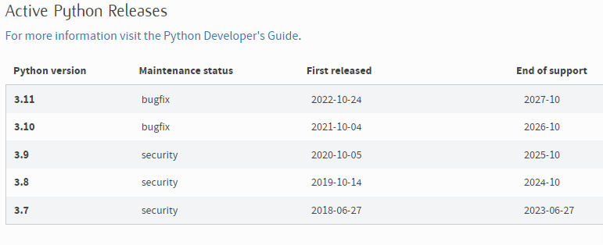
Introduction to Python
V. 3.X เป็น Version ในปัจจุบัน
V. 2.X ยังคงมีการใช้งานอยู่แต่หยุดการพัฒนาแล้ว
คู่มือสามารถหาอ่านเพิ่มเติมได้ https://docs.python.org/3/tutorial/index.html
https://www.python.org/downloads/

Slide 20
Why Python?
Python is an open-source, general-purpose high-level programming language.
Term | Definition
Open-source software (OSS) | Open-source means it is free. Python has a large and active scientific community with access to the software’s source code and contributes to its continuous development and upgrading, depending on users’ needs.
General-purpose | There is a broad set of fields where Python could be applied – web programming, analysis of financial data, analysis of big data, and more.
High-level | High-level languages employ syntax a lot closer to human logic, which makes the language easier to learn and implement.
Python’s popularity lies on two main pillars. One is that it is an easy-to-learn programming language designed to be highly readable, with a syntax quite clear and intuitive. And the second reason is its user-friendliness does not take away from its strength. Python can execute a variety of complex computations and is one of the most powerful programming languages preferred by specialists.

Slide 21
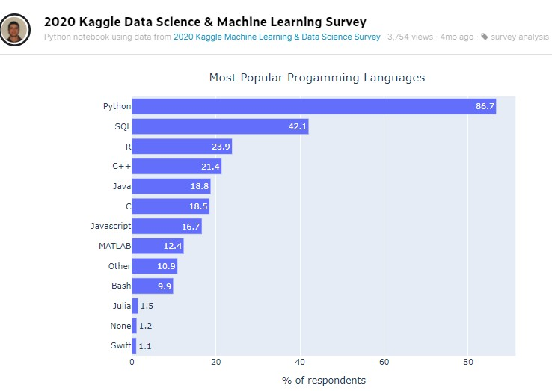
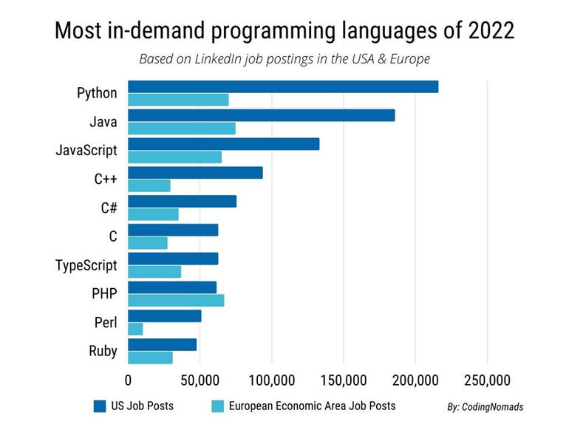
Programming Languages
Credit: https://www.kaggle.com/paultimothymooney/2020-kaggle-data-science-machine-learning-survey

Slide 22
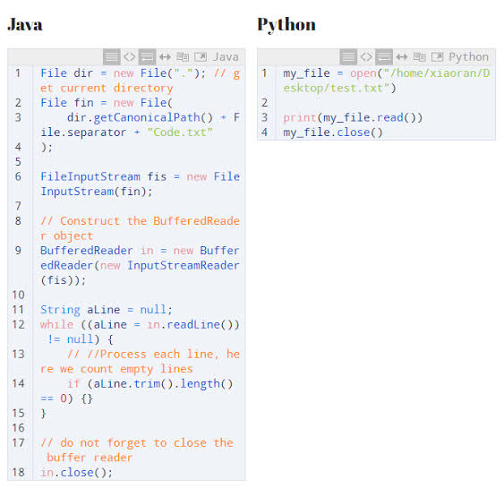
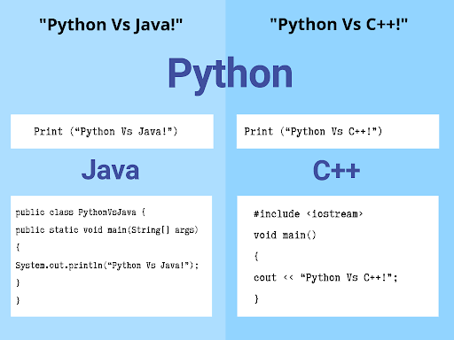
Programming Languages

Slide 23
Introduction to Jupyter Notebook and Google Co-Lab

Slide 24

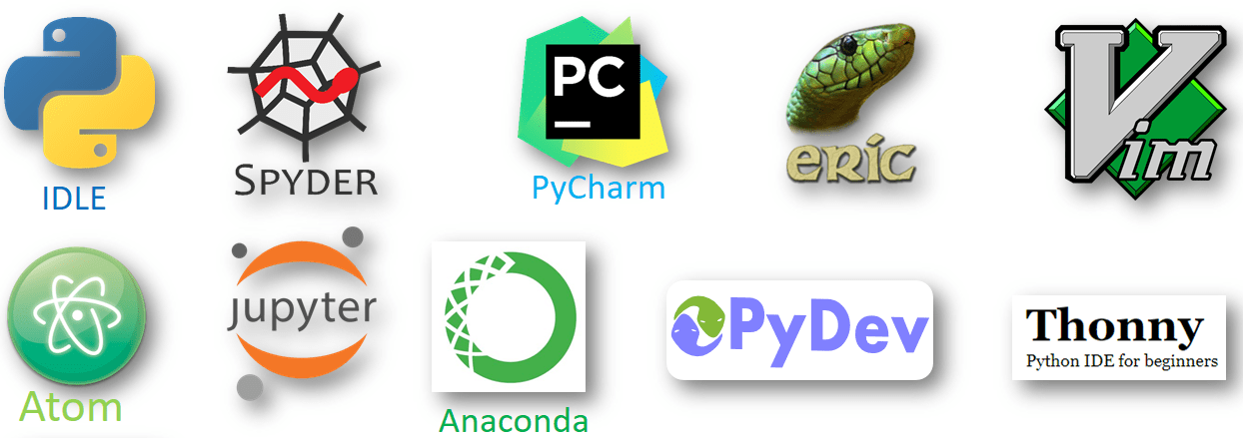
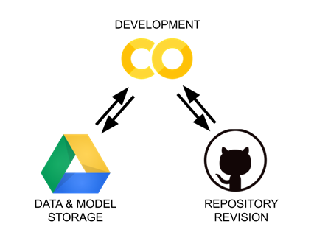

Python Development Environments
This Class use Google Colab
** Cloud + Free **

Slide 25

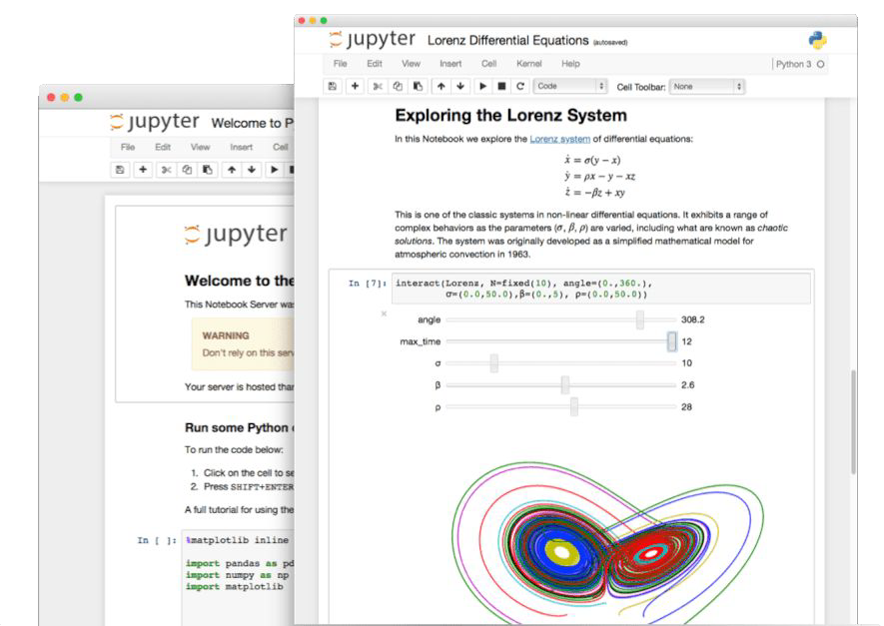
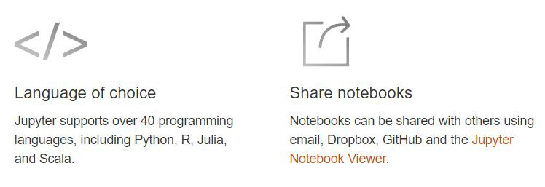
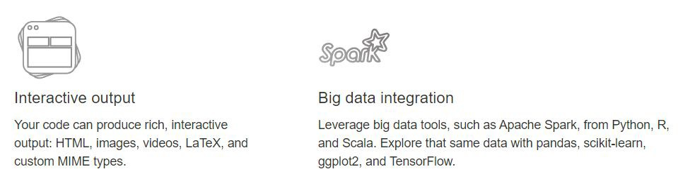
Jupyter Notebook
a web-based interactive computing platform
เรียกใช้งาน library พร้อมทั้งเขียน code และดูผล ได้เลย

Slide 26
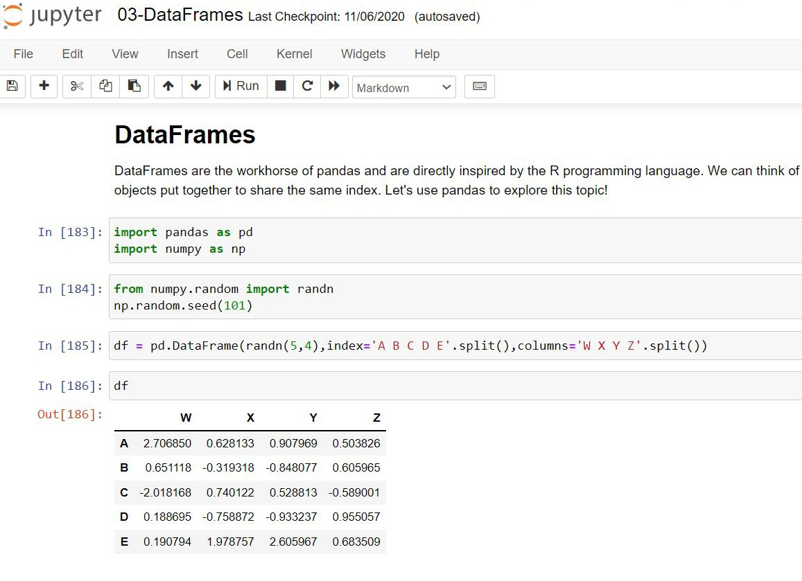
Jupyter Notebook
Text Cell
Code Cell

Slide 27

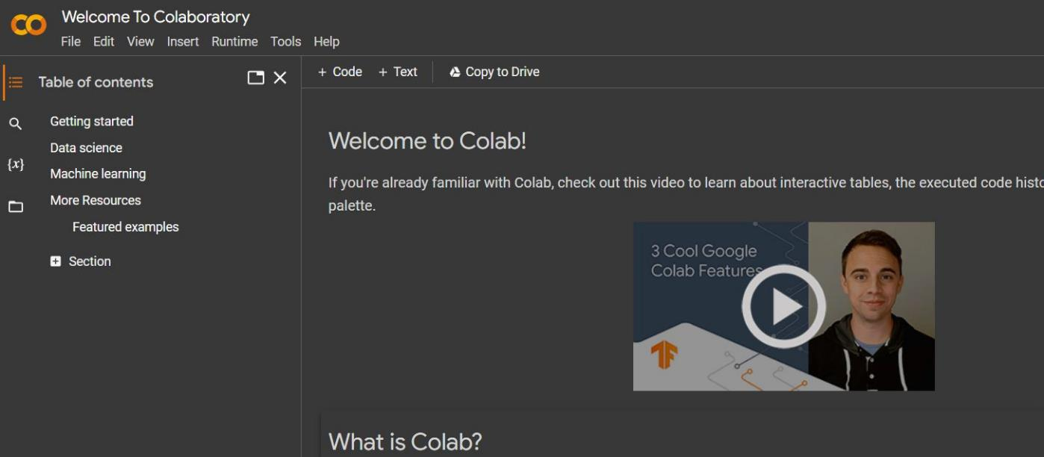
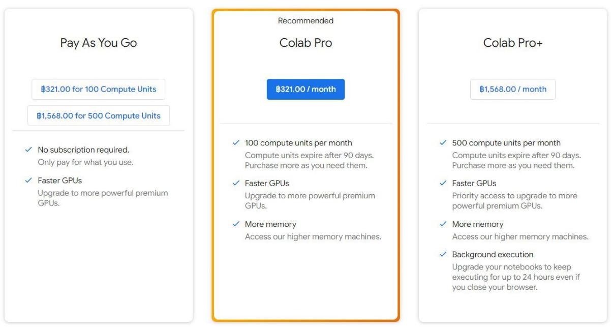
Google Colab
Free Jupyter notebook environment that runs entirely in the cloud.
write and execute Python in your browser
Advantage
Zero configuration required
Access to GPUs free of charge
Easy sharing
Disadvantage
Internet connection needed
Limit memory and runtime (free plan)
What Colab offer you?
Write and execute code in Python
Create/Upload/Share notebooks
Import/Save notebooks from/to Google Drive
Import/Publish notebooks from GitHub
Import external datasets e.g. from Kaggle
Integrate PyTorch, TensorFlow, Keras, OpenCV
Free

Slide 28
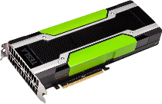
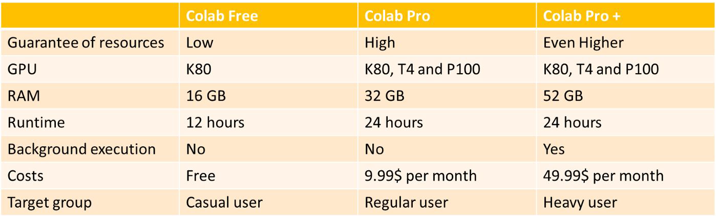
Google Colab
What Colab offer you?
Free Cloud service with free GPU
For This Course ,
Free Version is enough !!

Slide 29
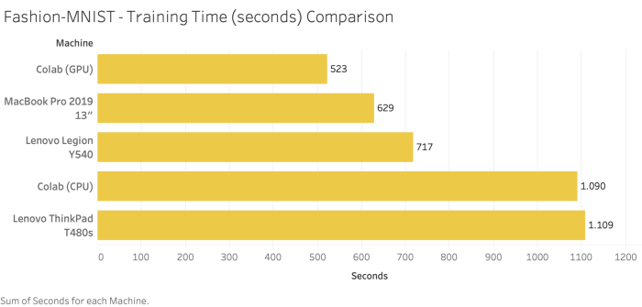
Google Colab

Slide 30


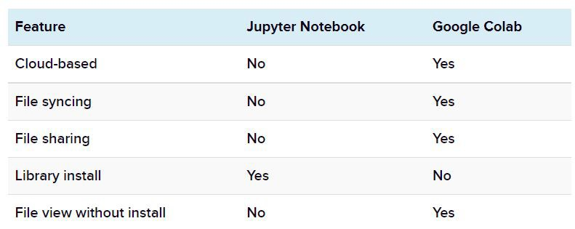


Jupyter Notebook vs Google Colab
This Class use Google Colab
** Cloud + Free **

Slide 31
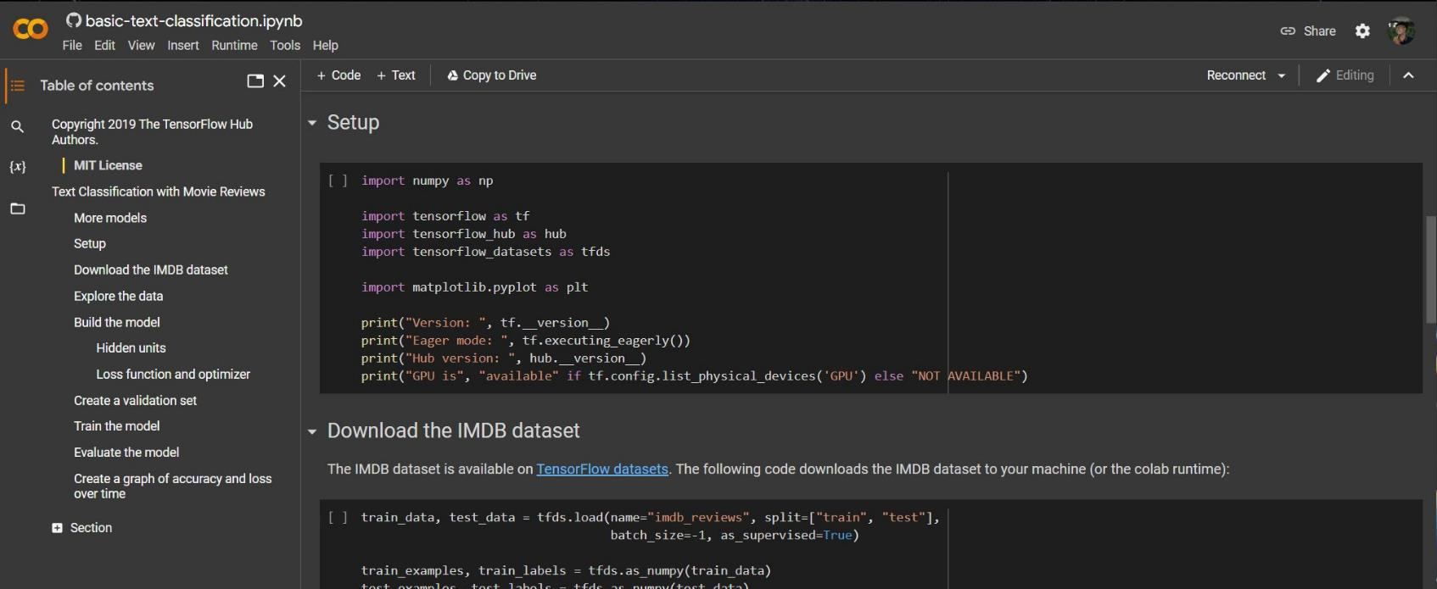
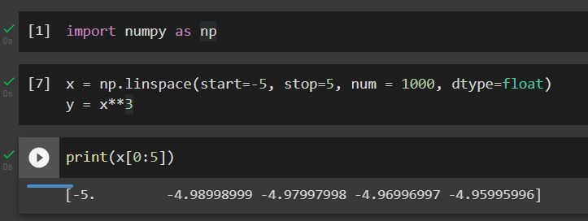
Google Colab Interface
Menu bar
Working Space
Side Bar
Code
Output
https://colab.research.google.com/

Slide 32
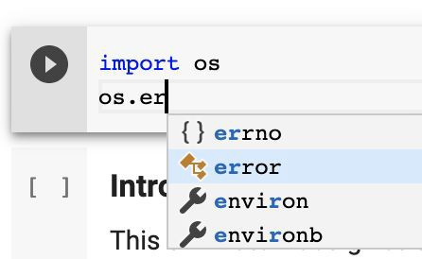
Google Colab
If you now insert your cursor after `imported library` and press Period(`.`), you will see the list of available completions within the `imported library` module. Completions can be opened again by using **Ctrl+Space**.

Slide 33
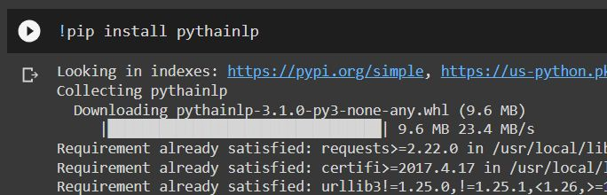
Google Colab
To import a library that's not in Colaboratory by default, you can use
!pip install …<library name>... or
!apt-get install …<library name>
Command Scripts
Any command that works at the command-line can be used in code cell by prefixing it with the ! or %
%cd, %cp, %cat, %mkdir, %pwd,
%ls, %rmdir, %dir, %rm, %md

Slide 34
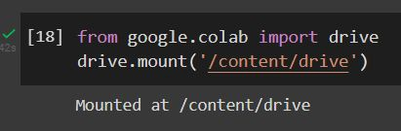
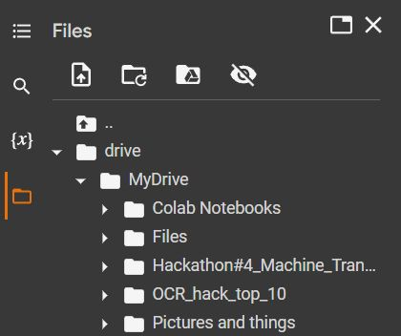
Google Colab
Mounting your Google Drive in the runtime's virtual machine

Slide 35
First for use Google Colab

Slide 36
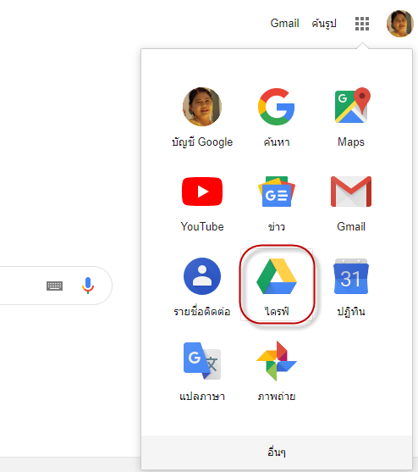
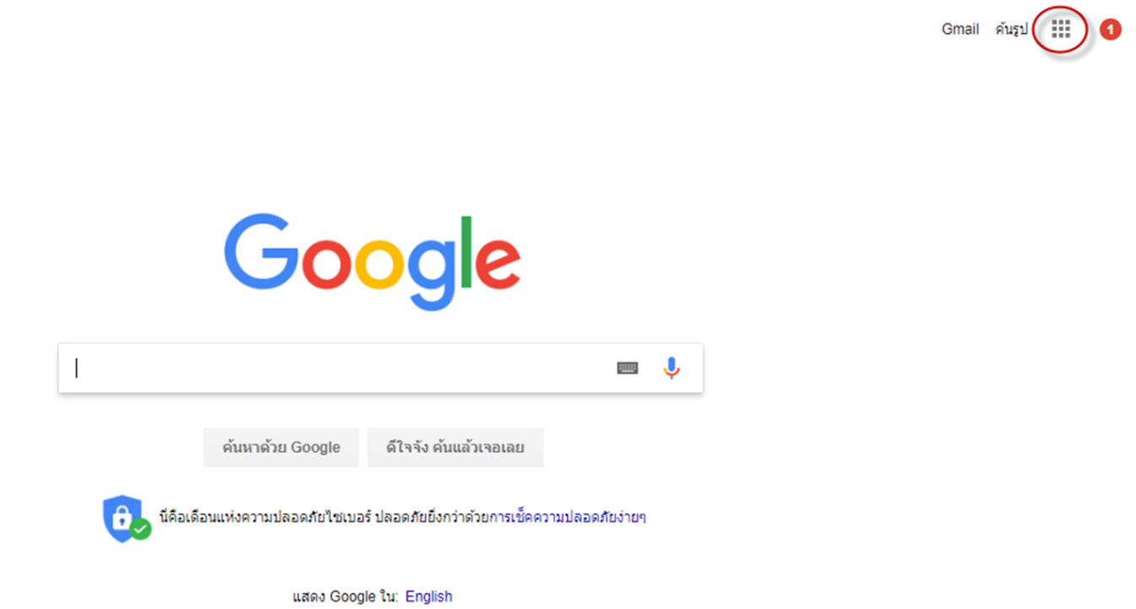
Google Colab
** Must have Google Account
1
2

Slide 37


Google Colab
3
4
Credit:

Slide 38



Google Colab
5
6
7

Slide 39

Google Colab
Ready ???
8
Or Click https://colab.research.google.com/

Slide 40


Google Colab
More : https://lengyi.medium.com/google-colab-tpu-e0ed8af776b3

Slide 41



Google Colab
Tesla K80 For free!!

Slide 42

Top Python Libraries
Credit: https://learnpython.com/blog/top-python-libraries-2020/

Slide 43



Copy to Your Drive!!
Your Drive
Your file
Always Copy to Your Drive , when you copy another code.

Slide 44
1. Python Operators and Variables

Slide 45

Python Operators

Slide 46

Python Operators
Python Operators Precedence Rule – PEMDAS
Firstly, parentheses will be evaluated, then exponentiation and so on.
P – Parentheses ( )
E – Exponentiation **
M – Multiplication *
D – Division / // %
A – Addition +
S – Subtraction -
Left -> Right
Example : (43+13−9/3∗7)

Slide 47
Python Operators
Python Operators Precedence Rule – PEMDAS
Firstly, parentheses will be evaluated, then exponentiation and so on.
P – Parentheses ( )
E – Exponentiation **
M – Multiplication *
D – Division / // %
A – Addition +
S – Subtraction -
Left -> Right
Example : (43+13−9/3∗7)
43 + 13 – 3 * 7

Slide 48
Python Operators
Python Operators Precedence Rule – PEMDAS
Firstly, parentheses will be evaluated, then exponentiation and so on.
P – Parentheses ( )
E – Exponentiation **
M – Multiplication *
D – Division / // %
A – Addition +
S – Subtraction -
Left -> Right
Example : (43+13−9/3∗7)
43 + 13 – 3 * 7
43 + 13 – 21

Slide 49
Python Operators
Python Operators Precedence Rule – PEMDAS
Firstly, parentheses will be evaluated, then exponentiation and so on.
P – Parentheses ( )
E – Exponentiation **
M – Multiplication *
D – Division / // %
A – Addition +
S – Subtraction -
Left -> Right
Example : (43+13−9/3∗7)
43 + 13 – 3 * 7
43 + 13 – 21
35

Slide 50


Logical operators

Slide 51


Adding text styles using Markdown & Comment

Slide 52

Rules of Naming a Variable in Python
It must start with a letter or the underscore (_).
It should not start with a number.
It should only contain alpha-numeric characters and underscores (A-z, 0-9, and _ ). It should not have any other characters or spaces.
The names are case-sensitive (i.e., DataMommie and datamommie are treated as different variables).
It should not be a keyword.

Slide 53


Variables
One of the main concepts in programming is variables. They are your best friends. You will deal with them all the time. You will use them to store information. They will represent your data input.
Let’s say you want to have a variable x that is equal to the value of 5 and then ask the computer to tell you the value of that variable. Type x equals 5.
Write x and then execute the cell. And here’s the
result: 5.
An alternative way to execute the instruction that will provide the value we assigned to y would be to use the print() function.
If we say “print(y)”, the machine will simply execute this command and provide the value of y as a result.

Slide 54
Break 15 mins

Slide 55
2. Functions

Slide 56

4. Functions

Slide 57

Defining a Function in Python
Python’s functions are an invaluable tool for programmers.
indent
To tell the computer you are about to create a function, just write def at the beginning of the line. Def is neither a command nor a function. It is a keyword. To indicate this, Jupyter will automatically change its font color to green. Then, you can type the name of the function you will use. Then, you must add a pair of parentheses. Technically, within these parentheses, you could place the parameters of the function if it requires you to have any. It is no problem to have a function with zero parameters.
To proceed, don’t miss to put a colon after the name of the function.
Since it is inconvenient to continue on the same line when the function becomes longer, it is much better to build the
habit of laying the instructions on a new line, with an indent again. Good legibility counts for а good style of coding!

Slide 58

Creating a Function with a Parameter
In programming, return regards the value of y; it just says to the machine “after the operations executed by the function f, return to me the value of y”. “Return” plays a connection between the second and the third step of the process. In other words, a function can take an input of one or more variables and return a single output composed of one or more values. This is why “return” can be used only once in a function.
People often confuse print and return, and the type of situations when we can apply them.

Slide 59

print vs. return
print() takes a statement or, better, an object, and provides its printed representation in the output cell. It just makes a certain statement visible to the programmer. Otherwise, print() does not affect the calculation of the output.
Differently, return does not visualize the output. It specifies what a certain function is supposed to give back.
It’s important you understand what each of the two keywords does. This will help you a great deal when working with functions.

Slide 60

Using a Function in Another Function
It isn’t a secret we can have a function within the function.
In with_bonus(w_hours), you can return directly the wage with working hours as an output, which would be the value obtained after the wage function has been run, plus 50.

Slide 61

Creating Functions Containing a Few Arguments
You can work with more than one parameter in a function. The way this is done in Python is by listing all the arguments within the parentheses, separated by a comma.

Slide 62


Creating Functions Containing a Few Arguments
You can call the function for, say, 10, 3, and 2. You will get 4.
Just be careful with the order in which you state the values. In this case, we assigned 10 to the variable a, 3 to b, and 2 to c.
Otherwise, the order won’t matter if you specify the names of the variables within the parentheses.

Slide 63
Notable Built-In Functions in Python
When you install Python on your computer, you are also installing some of its built-in functions. This means you won’t need to type their code every time you use them – these functions are already on your computer and can be applied directly.
Function | Description
type() | obtains the type of variable you use as an argument
int() | transforms its argument in an integer data type
float() | transforms its argument in a float data type
str() | transforms its argument in a string data type
max() | Returns the highest value from a sequence of numbers
min() | Returns the lowest value from a sequence of numbers
abs() | Allows you to obtain the absolute value of its argument
sum() | Calculates the sum of all the elements in a list designated as an argument

Slide 64
Notable Built-In Functions in Python
Function | Description
round(x,y) | returns the float of its argument (x), rounded to a specified number of digits (y) after the decimal point
pow(x,y) | returns x to the power of y
len() | returns the number of elements in an object

Slide 65
Break - Lunch

Slide 66
3. Data Types

Slide 67

Types of Variables

Slide 68
Numbers and Boolean Values
When programming, not only in Python, if you say that a variable has a numeric value, you are being ambiguous.
The reason is that numbers can be integers or floating points, also called floats, for instance.
Term | Definition
Integer | Positive or negative whole numbers without a decimal point Example: 5, 10, -3, -15
Floating point (float) | Real numbers. Hence, they have a decimal point Example: 4.75, -5.50, 11.0
Boolean value | a True or False value, corresponding to the machine’s logic of understanding 1s and 0s, on or off, right or wrong, true or false. Example: True, False

Slide 69

Strings
Strings are text values composed of a sequence of characters.
Type single or double quotation marks around the name George. Python displays ‘George’ if you don’t use the print() function. Should you use print(), the output will be shown with no quotes – you’ll be able to see plain text.

Slide 70

Strings
Strings are text values composed of a sequence of characters.
To type “I’m fine” you’ll need the apostrophe in the English syntax, not for the Pythonic one.
In such situations, you can distinguish between the two symbols – put the text within double quotes and leave the apostrophe, which technically coincides with the single quote between I and M.
An alternative way to do that would be to leave the quotes on the sides and place a back slash before the apostrophe within the phrase.
This backslash is called an escape character, as it changes the interpretation of characters immediately after it.
To state “press “Enter””, the outer symbols must differ from the inner ones. Put single quotes on the sides.

Slide 71

Strings
Strings are text values composed of a sequence of characters.
Say you wish to print “Red car” on the same line. “Add” one of the strings to the other by typing in a plus sign between the two. Put a blank space before the second apostrophe of the first word.
(In [17])
Type print(‘Red’, and then put a comma, which is called a trailing comma, and Python will print the next word, ‘car’, on the same line, separating the two words with a blank space. (In [18])

Slide 72
4. Conditional Statements

Slide 73

Conditional Statements
Notes:
ให้ทราบว่ามีอะไรบ้าง เวลาใช้งานจริงๆ อาจจะไม่จำเป็น ต้องเปิด หนังสือหาอยู่ดี
ไม่รู้ หา Google
How to

Slide 74

Introduction to the IF statement
A prominent example of conditional statements in Python is the “If” statement. What you can use it for is intuitive, but it is very important to learn the syntax.

Slide 75

Introduction to the IF statement
The graph could help you imagine the process of the conditionals. Before it displays the outcome of the operation, the machine follows these logical steps. If the conditional code is not to be executed because the if-condition is not true, the program will directly lead you to some other output or, as it is in this case, to nothing. After any of the two situations, the machine will go to the next black point and will progress from there on.

Slide 76

Add an ELSE statement
“Else” will tell the computer to execute the successive command in all other cases.

Slide 77

Add an ELSE statement
Instead of leading to no output, if the condition is false, we will get to an else code. Regardless whether the initial condition is satisfied, we will get to the end point, so the computer has concluded the entire operation and is ready to execute a new one.

Slide 78

Else if, for Brief - ELIF
If y is not greater than 5, the computer will think: “else if y is less than 5”, written “elif y is less than 5”, then I will print out “Less”.
Know that you can add as many elif statements as you need.

Slide 79

Else if, for Brief - ELIF
A very important detail you should try to remember is that the computer always reads your commands from top to bottom. Regardless of the speed at which it works, it executes only one command at a time. Scientifically speaking, the instructions we give to the machine are part of a control flow. This is something like the flow of the logical thought of the computer, the way the computer thinks – step by step, executing the steps in a rigid order.
When it works with a conditional statement, the computer’s task will be to execute a specific command once a certain condition has been satisfied. It will read your commands from the if- statement at the top, through the elif-statements in the middle, to the else- statement at the end. The first moment the machine finds a satisfied condition, it will print the respective output and will execute no other part of the code from this conditional.

Slide 80

A Note on Boolean Values
From a certain perspective everything in a computer system is Boolean comprising sequences of 0s and 1s, “False” and “True”. This is why we are paying attention to the Boolean value. It helps us understand general computational logic and the way conditionals work in Python.
Basically, after you insert your if-statement, the computer will attach a Boolean value to it. Depending on the value of its outcome, “True” or “False”, it will produce one of the suggested outputs, “Correct” or “Incorrect”.

Slide 81
Container / Sequences 5. List 6.Tuple

Slide 82

Lists
A list is a type of sequence of data points such as floats, integers, or strings.
You can access the Participants list by indexing the value 1. This means you have extracted the second of the elements in this list variable [‘Leila’].
In addition, there is a way to get to the last element from your list. To do that, start counting from the end towards the beginning. Then, you’d need the minus sign before the digit.
Don’t fall in the trap of thinking we begin enumerating from 0 again! To obtain “Cate”, you must write -1.

Slide 83

List Slicing
Many of the problems that must be solved will regard just a portion of the data, and in such cases, you can apply slicing.
Imagine you want to use the “Participants” list to obtain a second much smaller list that contains only two names - Leila and Maria. In Pythonic, that would mean to extract the elements from the first and second position. To access these elements, we will open square brackets, just as we did with indexing, and write 1 colon 3. The first number corresponds precisely to the first position of interest, while the second number is one position above the last position we need.

Slide 84

Help Yourself with Methods
Here is the syntax that allows you to call ready-made built-in methods that you do not have to create on your own and can be used in Python directly.
After the name of the object, which in this case is the “Participants” list, you must put a dot called a dot operator. The dot operator allows you to call or invoke a certain method. To call the method “append”, state its name, followed by parentheses.
To insert the name “Dwayne” in our list, you must put the string “Dwayne” in inverted commas between the
parentheses.

Slide 85

Help Yourself with Methods
Alternatively, the same result can be achieved by using the .extend() method. This time, within the parentheses, you’ll have to add brackets, as you are going to extend the Participants list by adding a list specified precisely in these parentheses.

Slide 86

Tuples
Tuples are another type of data sequences, but differently to lists, they are immutable. Tuples cannot be changed or modified; you cannot append or delete elements.
The syntax that indicates you are having a tuple and not a list is that the tuple’s elements are placed within parentheses, not brackets.
The tuple is the default sequence type in Python, so if you list three values here, the computer will perceive the new variable as a tuple. We could also say the three values will be packed into a tuple.
For the same reason, you can assign a number of values to the same number of variables. On the left side of the equality sign, add a tuple of variables, and on the right, a tuple of values. That’s why the relevant technical term for this feature is tuple assignment.

Slide 87
7. Loops in Python

Slide 88
Conditional Statements
Notes:
ให้ทราบว่ามีอะไรบ้าง เวลาใช้งานจริงๆ อาจจะไม่จำเป็น ต้องเปิด หนังสือหาอยู่ดี
ไม่รู้ หา Google
How to

Slide 89

For Loops
Iteration is a fundamental building block of all programs. It is the ability to execute a certain code repeatedly.
The list even contains all the even numbers from 0 to 20.
for n in even, colon,
which would mean for every element n in the list even, do the following:
print that element.
The command in the loop body is performed once for each element in the even list.

Slide 90


While Loops and Incrementing
The same output we obtained in the previous lesson can be achieved by using a while- loop, instead of a for- loop. However, the structure we will use will be slightly different.
Initially, we will set a variable x equal to zero. And we’ll say: while this value is smaller than or equal to 20, print x.
We want to get the loop to end. What is supposed to succeed, the loop body in the “while” block, is a line of code that specifies a change in x or what has to happen to x after it is printed. In our case, we will tell the computer to bind x to a value equal to x + 2.
In programming terms, adding the same number on top of an existing variable during a loop is called incrementing. The amount being progressively added is called an increment. In our case, we have an increment of 2.
The Pythonic syntax offers a special way to
indicate incrementing: x += 2

Slide 91

Create Lists with the range() Function
When you need to randomize data points and lists with data points, you can use Python’s built-in
range() function.
The syntax of the function is the following:
The stop value is a required input, while the start and step values are optional. If not provided, the start value will be automatically replaced with a 0, and the step value would be assumed to be equal to 1.

Slide 92

Create Lists with the range() Function
range(10) will provide a list of 10 elements, starting from 0, implied after not indicating a start value, and ending at the tenth consecutive number - 9.
In another cell, if in the range() function we declare as arguments 3 and 7, for instance, Python will accept 3 as a start
value, and 7 as a stop value of the range. So, we’ll have 4 elements – 3, 4, 5, and 6.
To specify a step value in a range, the other two arguments must be chosen as well. range(1,20,2) creates a list including all the odd numbers from 1 to 19. It will start with the number 1, and the list will end with number 19 (which equals the stop value 20 minus 1), stating only the odd numbers.

Slide 93

Use Conditional Statements and Loops Together
You create an iteration that includes a conditional in the loop body. You can tell the computer to print all the even values between 0 and 19 and state “Odd” in the places where we have odd numbers.
Let’s translate this into computational steps.
If x leaves a remainder of 0 when divided by 2, which is the same as to say “if x is even”, then print x on the same line.
else, which means unless x is even, or if x is odd, print “Odd”.

Slide 94

All In – Conditional Statements, Functions, and Loops
We use iterations when we want to go through variables that are part of a list.
You can count the number of items whose value is less than 20 in a list. First, define a function that takes as an argument numbers, where numbers will be a certain list variable. The trick is to create a variable that, so to speak, “departs” from 0. Let’s call it total.
The idea is that, when certain conditions are verified, total will change its value. That’s why, in such a situation, it is appropriate to call this variable a rolling sum.
More technically, when we consider x in the numbers list, if it is smaller than 20, we will increment the total by 1 and finally return the total value. This means that, if x is less than 20, total will grow by 1, and if x is greater than or equal to 20, total will not grow. So, for a given list, this count() function will return the amount of numbers smaller than 20.

Slide 95
Container / Sequences 8. Dictionary
Notes:
ให้ทราบว่ามีอะไรบ้าง เวลาใช้งานจริงๆ อาจจะไม่จำเป็น ต้องเปิด หนังสือหาอยู่ดี
ไม่รู้ หา Google
How to

Slide 96


Dictionaries
Dictionaries represent another way of storing data.
dict
key | k1 | k2 | k3 | k4
value | cat | dog | mouse | fish
Each value is associated with a certain key. More precisely, a key and its respective value form a key-value pair. After a certain dictionary has been created, a value can be accessed by its key, instead of its index!
Similarly, as we could do with lists, we can add a new value to the dictionary in the following way: the structure to apply here is dictionary name, new key name within brackets, equality sign, and the name of the new value.

Slide 97
9. Modules and library functions
Notes:
ให้ทราบว่ามีอะไรบ้าง เวลาใช้งานจริงๆ อาจจะไม่จำเป็น ต้องเปิด หนังสือหาอยู่ดี
ไม่รู้ หา Google
How to

Slide 98




Object-Oriented programming (OOP)

Slide 99
Object-Oriented programming (OOP)
Float
Strings
Logical Objects
Integer
Lists….

Slide 100
Object-Oriented programming (OOP)
List_temp_c
Point 1 | 24
Point 2 | 26
Point 3 | 25
Point 4 | 24
Point 5 | 26
….. | …..
Point 24 | 32
List_temp_c = [ 24 , 26 , 25 , 24 , 26 ,… , 32 ]
24 data points
Dict_name_Gallery
Names :
‘National Gallery’ ,
Dict_name_Gallery = { ‘Name’ : ‘National Gallery’ , ….. }
‘Central Gallery’ ,
….

Slide 101

Object-Oriented programming (OOP)
Object = Data + Manipulation Operation
Object :
Attributes :
Method :
Red
.turn_left()
A
Color
Black
Green
.turn_right()
Size
12 inches
.break()
16 inches
“Bike” Class
.accelerate()
Type
Touring
Mountain

Slide 102
Object-Oriented programming (OOP)
Object = Data + Manipulation Operation
“List” Class
Object :
Attributes :
Method :
.extend()
[ 15.9 , 12.4 , 64.0 ]
float
.index()

Slide 103
module vs package vs library
module
is a simple Python file that contains collections of functions and global variables.
Examples of modules:
Datetime
Regex
Random etc.
package
a simple directory having collections of modules.
Examples of Packages:
Numpy
Pandas
module
module
module
module
library
is having a collection of related functionality of codes
It is a reusable chunk of code that we can use by importing it into our program, we can just use it by importing that library and calling the method of that library with a period(.)
Examples of Libraries:
Matplotlib
Pytorch
Pygame
Seaborn etc.

Slide 104





module vs package vs library

Slide 105

Python Standard Library

Slide 106






Importing Modules
ไม่นิยมใช้ * (all)
เพราะ ทำให้เราไม่รู้จริงๆ ว่า Library ที่ใช้จริงๆ คืออะไร
ถ้าเป็น Module ใหญ่ๆ จะเปลืองทรัพยากร

Slide 107
10. Introduction to Using NumPy

Slide 108

Introduction to Using NumPy and pandas
NumPy is the fundamental package for scientific computing in Python.
https://numpy.org/doc/stable/user/absolute_beginners.html

Slide 109

Numerical Computing with Python and Numpy

Slide 110


Numpy
A Collection of pre-written functions, class and methods which are capable of handling and manipulating data and calculating results
Main feature : Arrays
Stores multiple types of data
Works in a lower level language => Shorter computation times
Useful universal functions and methods designed specifically
NumPy is an open-source numerical Python library.
NumPy contains a multi-dimensional array and matrix data structures.
It can be utilized to perform a number of mathematical operations on arrays such as trigonometric, statistical, and algebraic routines. Therefore, the library contains a large number of mathematical, algebraic, and transformation functions.
NumPy is an extension of Numeric and Numarray.
Numpy also contains random number generators.
NumPy is a wrapper around a library implemented in C.
Pandas objects rely heavily on NumPy objects. Essentially, Pandas extends Numpy.
Cheat sheet Numpy :
https://machinelearningmastery.com/wp-content/uploads/2022/04/cheatsheet.png
https://numpy.org/doc/stable/user/whatisnumpy.html

Slide 111



Matrices
Mathematics
Element
Pragramming
Operations
Addition
Subtraction
Multiplication
….

Slide 112

Concatenate

Slide 113
Matrices
Matrices
Vector
Scalar
15
5
-2
4
0D
1D
2D

Slide 114

Addition / Subtraction
Very Easy
The 2 matrices must have to same dimensions

Slide 115

Transpose

Slide 116

Dot product
Vector

Slide 117



Dot product
Matrices

Slide 118

Array indexing and slicing

Slide 119

Why is Linear Algebra Useful?

Slide 120



Why is Linear Algebra Useful?

Slide 121


Why is Linear Algebra Useful?

Slide 122





Why is Linear Algebra Useful?
Dog ?
Cat ?
??
1D Matric
3D Matric

Slide 123



Why is Linear Algebra Useful?

Slide 124
11. Analyzing Tabular Data with Pandas

Slide 125

Introduction to Using NumPy and pandas
is an open source, BSD-licensed library providing high-performance, easy-to-use data structures (json , xlsx , csv , sql , html, etc.) and data analysis tools for the Python programming language.
https://pandas.pydata.org/docs/getting_started/index.html

Slide 126




Introduction to Pandas
Documentation
Visualization
Makes out work much faster and easier
Faster and easier data analysis and Visualization
Import / Export .csv, .xls , .json , .npz
Cheat sheet Pandas :
https://pandas.pydata.org/Pandas_Cheat_Sheet.pdf

Slide 127

Introduction to Pandas

Slide 128



Combining Dataframe
https://pandas.pydata.org/docs/user_guide/merging.html

Slide 129
8. Visualization with Matplotlib and Seaborn

Slide 130


Visualization with Matplotlib and Seaborn

Slide 131

Visualization with Matplotlib and Seaborn
https://matplotlib.org/stable/gallery/index
https://matplotlib.org/cheatsheets/

Slide 132

Visualization with Matplotlib and Seaborn
https://seaborn.pydata.org/
https://seaborn.pydata.org/tutorial/introduction.html

Slide 133

What have you learned?
Data Visualization
From Non-Coder to Coder

Slide 134


Plotly
https://plotly.com/

Slide 135
9. Web Scraping with BeautifulSoup

Slide 136

Web Scraping with BeautifulSoup

Slide 137
## Additional
Notes:
ให้ทราบว่ามีอะไรบ้าง เวลาใช้งานจริงๆ อาจจะไม่จำเป็น ต้องเปิด หนังสือหาอยู่ดี
ไม่รู้ หา Google
How to

Slide 138



You can get free certificates
https://www.kaggle.com/learn

Slide 139
Exploratory Data Analysis using Python - A Case Study
Notes:
ให้ทราบว่ามีอะไรบ้าง เวลาใช้งานจริงๆ อาจจะไม่จำเป็น ต้องเปิด หนังสือหาอยู่ดี
ไม่รู้ หา Google
How to

Slide 140

Exploratory Data Analysis using Python - A Case Study

Slide 141
Visualization with Plotly
Notes:
ให้ทราบว่ามีอะไรบ้าง เวลาใช้งานจริงๆ อาจจะไม่จำเป็น ต้องเปิด หนังสือหาอยู่ดี
ไม่รู้ หา Google
How to

Slide 142


Visualization with Plotly
https://plotly.com/python/

Slide 143

Visualization with Plotly
https://plotly.com/python/

Slide 144

ChatGPT
https://openai.com/research/overview
https://openai.com/blog/chatgpt
https://chat.openai.com/

Slide 145
Data Science Life Cycle
Credit: The Data Science Process. A Visual Guide to Standard Procedures… | by Chanin Nantasenamat | Towards Data Science
Credit: https://miro.medium.com/max/2400/1*-8sSf4po2pm-fzhBU7CUmQ.jpeg

Slide 146






Auto Model
https://autokeras.com/
https://pycaret.org/tutorial/
https://docs.fast.ai/tutorial.html
https://automl.github.io/auto-sklearn/master/
https://auto.gluon.ai/stable/index.html
https://optuna.readthedocs.io/en/stable/tutorial/index.html

Slide 147


Reference
https://github.com/Mckiler
https://medium.com/@mcmckiler
https://www.projectpro.io/article/python-data-visualization-libraries/543
https://www.simplilearn.com/top-python-libraries-for-data-science-article
Learning How to Learn

